Slide 1
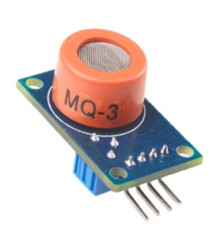

DEPARTMENT OF ELECTRONICS AND COMMUNICATION ENGINEERING
PROJECT
PANDEMIC-PREVENTING SYSTEM BASED ON
MQ-3 SENSOR
GUIDED BY,
PRABAGARAN D, M.E
PROJECT BY,
P. HARIKARAN
M. VIJAY. DECE
M. SRIDHAR M
A. KIRUBHANITHI. DECE

Slide 2
CONTENT
Development board.
Basics of RFID.
How we use RFID?
Demo Video.
Conclusion.

Slide 3
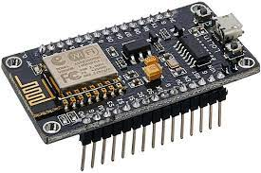
DEVELOPMENT BOARD
Node MCU is one of the most popular ESP8266 development boards.
It has 4MB of flash memory, 11 GPIO pins, and one ADC pin with 10-bit resolution.
This is what we use more often in our Wi-Fi and IoT projects.
It is extremely versatile and perfect for beginners.
It provide internet facility between I/O devices

Slide 4
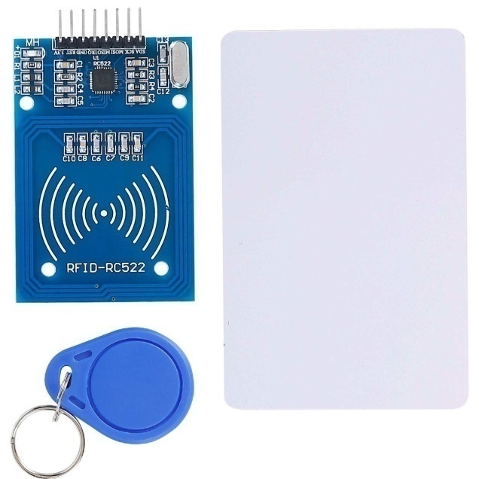
BASICS OF RFID
Radio Frequency Identification (RFID) refers to a wireless system comprised of two components: tags and readers.
The reader is a device that has one or more antennas that emit radio waves and receive signals back from the RFID tag.
By reading the UID of a card or
tag, we can find the data
stored about the UID (Name,
mail id, mobile number, etc)

Slide 5
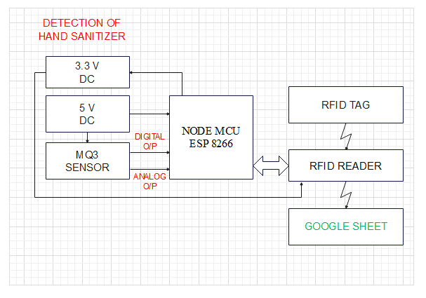
HOW WE USE RFID

Slide 6

DEMO VIDEO

Slide 7
CONCLUSION
By Using these devices we can reduce the transmission of viruses through hands.
The MQ3 sensor, servo motor, RFID, Arduino UNO and Node MCU are very low cost electronic devices, So the small shops also can afford these products easily.
These products can contribute to reducing the transmission of viruses during pandemic situations.

Slide 8



THANK YOU!

